Slide 1


Resumes, CVs, Cover Letters, and Some Resources
For American Vacuum Society @ Florida International University

Slide 2
Outline
Introductions
Career Services
Resumes
Curriculum vitae
Cover letters
Some Resources

Slide 3
Learning Objectives
At the end, individuals should be able to:
Explain what a resume and a CV are
Be able to list components of resumes and CVs
Know how to open a cover letter template
Find several online resources, such as ONET Online and NACE

Slide 4
Top 10 Skills Employers Seek
Ability to work on a team
Communication (verbal)
Communication (written)
Detail oriented
Flexibility / adaptability
Initiative
Leadership
Problem-solving skills
Strong work ethic
Technical skills
National Association of Colleges & Employers (NACE) Job Outlook 2012 Survey

Slide 5
Looking for Jobs
FIU Career Services Panther JOBlink
Career Fairs and information sessions
Employer websites
Student organizations
Professional associations
Direct contact with employers
Listservs
Newspapers/professional magazines
Employment agencies
Friends/Alumni/Networking

Slide 6
AVS Divisions
Advanced Surface Engineering
Applied Surface Science
Biomaterial Interfaces
Electronic Materials/Processing
Magnetic Interfaces & Nanostructures
Nanometer-Scale Science & Technology
Plasma Science/Technology
Surface Science
Thin Film Division
Vacuum Technology
(http://www.avs.org/about.aspx)

Slide 7
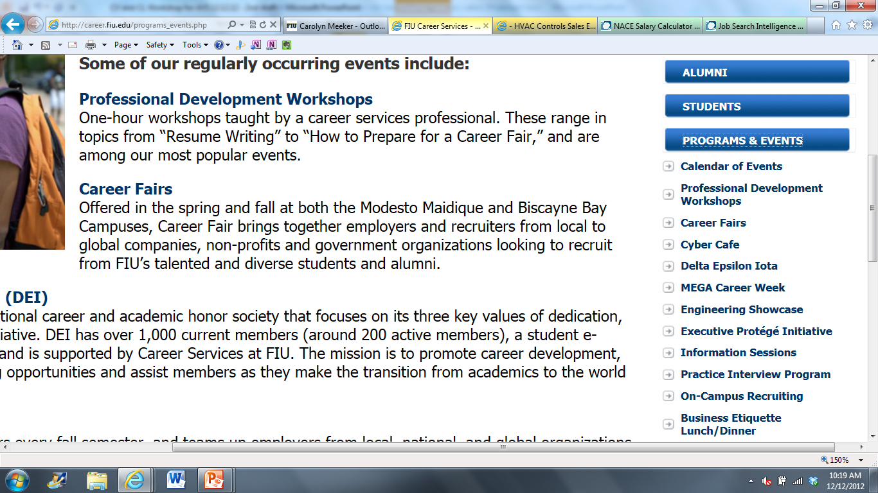
Career Services
Dg
Dfg

Slide 8
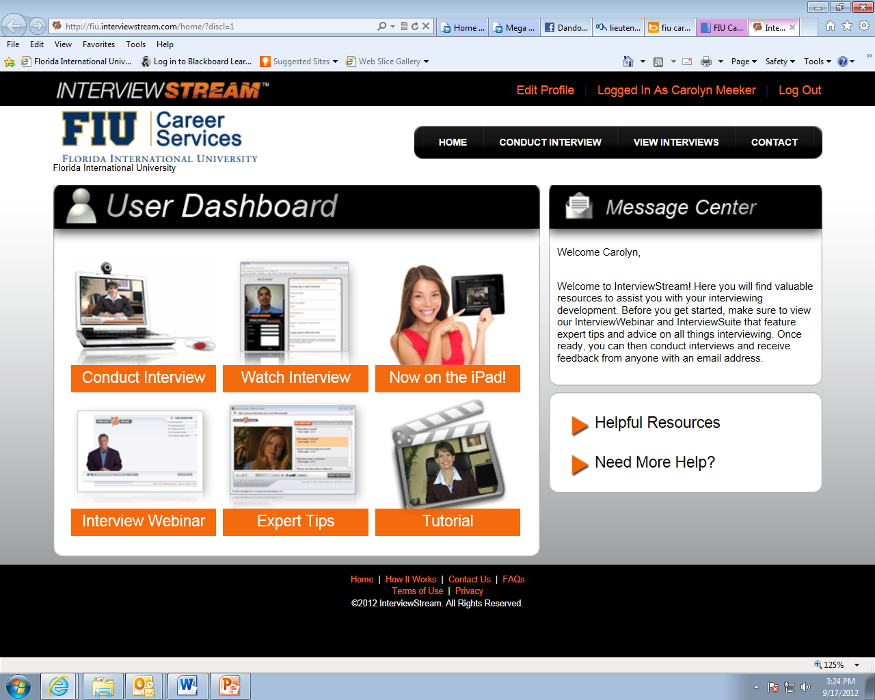
Panther JOBlink
Dg
Dfg

Slide 9
Some Spring and Summer Events
Career Boot Camp: Sat, 2/9/13, 9am-2:30pm, Engineering Center 2300
  How to Prepare for a Career Fair
  Resume Writing
  Using Panther JOBlink to Search for Jobs and Events
  Business Etiquette Lunch and Presentation
Spring 2013 BBC Career Fair: W, 2/6/13, 11am-3pm, BBC Wolfe University Center
Alumni and Employer Networking Event: W, 2/13/13, 6pm-8pm, GC Faculty Club
Spring 2013 MMC Career Fair: Th, 2/14/13, 3pm-7pm, MMC US Century Bank Arena
Engineering Expo: F, 2/22/13, 9am-2pm, Engineering Center
  1,400 K-12th students participate in tours and activities lead by student organizations
Engineering Student Showcase: Th, 4/11/13, 3pm-4:30pm, Engineering Center
  Student groups showcase their work and projects while employers visit their tables
Statewide Job Fair: Th, 5/9/13, UCF in Orlando, FL
Federal Government Statewide Conference: F, 6/28/13, MMC Graham Center

Slide 10
Why have a Resume / CV?
Marketing tool to secure a position or funding
Promotional materials
Professional representation of:
  Who you are ( Personal Information)
  What you want (Job/Scholarship)
  What you offer (Skills/Experience)

Slide 11
Difference between Resume and CV
The primary differences between a resume and a curriculum vitae (CV) are the length, what is included and what each is used for.
A resume is a one or two page summary of your skills, experience and education.
While a resume is brief and concise - no more than a page or two, a curriculum vitae is a longer (at least two page) and more detailed synopsis.
(http://jobsearch.about.com/cs/curriculumvitae/f/cvresume.htm)

Slide 12
A Few Resume Tips
Stay above the Rest → Replace common pieces
Experience
  Quality vs. Quantity (more is NOT always better)
  2-3 bullets on details (focused on job and results)
  Combine if possible (Designed, implemented and tested…)
GPA below Minimum Required
  If GPA is low, organize resume to highlight other areas
  Some recruiters suggest not adding it, as it will weed you out
  Some recruiters suggest adding it, as a resume without a GPA is considered incomplete

Slide 13

Resume Content and Sections
Personal Identification
Objective and/or Summary
Education
Experience
Qualities/Skills
Other

Slide 14

Personal Identification
Name, Address, Phone and email information
Style 1
Carolyn M. Meeker 10555 W. Flagler St, EC 2780 Miami, FL 33174 (305) 348-1281 carolyn.meeker@fiu.edu
Style 2
Carolyn Meeker 10555 W. Flagler St, EC 2780 ∙ Miami, FL 33174 ∙ 305.348.1281 ∙ carolyn.meeker@fiu.edu
Notes:
Name should be a larger font and in bold (preferably size 16 or 18)
Style 1 Takes up more space (to “FILL” Resume)
Style 2 Takes up less space (when space is limited)

Slide 15
Objective
1 – 3 lines describing who you are and what you’re seeking
  What are you interested in?
  What type of job you are looking for?
  What can you give to the company
Sample Objective (general-type)
Seeking a position in the field of Engineering
Sample Objective (Specific-Type)
Well-rounded student leader seeking a career with General Electric through the Edison Engineering Development Program
Notes:
What are you interested in?
Specific discipline or job/industry
What type of job are you looking for?
Internship, part time …
What can you give to the company?

Slide 16

Education
Institution, city, state
Degree earned or anticipated
Dates: YYYY, EGD: MM/DD/YYYY
GPA: X.X/4.0
Sample Education
Florida International University, Miami, Florida
Master of Science in Mechanical Engineering EGD: Dec 2013
GPA: 3.5/4.00
Bachelor of Science in Mechanical Engineering 2011
Minor in Physics
GPA: 3.8/4.00

Slide 17

Experience
Not a general job description!
  Verbs, results, impressive statistics
Team/Lead work
  Specify/focus on relevant projects you lead/participate
Volunteer Roles
  Led group, logistics, motivated team
Achievements-Oriented (Not Responsibilities-Oriented)
Sample Experience
Boeing, Everett, WA May 2010 - August 2010
Interiors Stress Engineering Intern
Assisted 777 Secondary Supports group meet deadlines by completing …
Performed Stress analysis on 787 Pilot/Co-Pilot Seat Pan tilt lock mechanism

Slide 18
Skills
Skills acquired during any activity (employment, projects, volunteer, sports) that can be applied at a later stage or in other situations
Transferable Skills Sets:
Dependability/Reliability Communication Skills
Problem Solving Ability Analytical Ability
Flexibility/Adaptability Initiative
Coping with Pressure/Deadlines Research Skills
Transferable Skills:
Project management Leading change
Preparing business plans Delegating tasks
Web design Finance management
Technology Spread sheets
Notes:
Presenter: MS

Slide 19

Skills
Categories
Computer skills
(Microsoft suite, C++...)
Technical skills/Industry Tools
(CNC Machine, Welding…)
Teamwork skills
(Leadership)
Analytical skills
(Critical thinking)
Language Skills
(Verbal and written)
Other, if relevant
Levels of Proficiency
Expert/Proficient
Knowledgeable/ Working knowledge of
Basic

Slide 20
Resume Formats
Chronological | Skills | Hybrid
Experience in reverse chronological order | Experience based on skill headings – not necessarily in chronological order | Usually experiences with descriptions in reverse chronological order; grouped under skill headings
Best when work, volunteer, and academics relate directly to job | Best when trying to break into a field with little or no experience. Changes | Best when no consistent themes to experience (sales, teaching, management, etc.)
Shows consistency in history. Not best if wide gaps in employment | Work history summarized in brief section at bottom | Provides easily identifiable skills areas and a sense of work history
Most common format | Skills are main attraction. Focus away from when and where developed
Pronunciation: kuh-rik-yuh-luhm vee-tahy (Dictionary.com)
Latin: Course of (one's) life or career
  Education, training, research, publications, job prep
Academia, medicine, teaching, research
Informative, but concise
  Eagle Scout, not every badge
Understated, but name dropping’s okay
Style and format vary by discipline (for example, APA 6th)

Slide 21
Curriculum Vitae
Pronunciation: kuh-rik-yuh-luhm vee-tahy (Dictionary.com)
Latin: Course of (one's) life or career
  Education, training, research, publications, job prep
Academia, medicine, teaching, research
Informative, but concise
  Eagle Scout, not every badge
Understated, but name dropping’s okay
Style and format vary by discipline (for example, APA 6th)

Slide 22
Curriculum Vitae
2-4 pages for new professionals
3-7 pages for experienced professionals
10 pages max, though some are much longer
Action verbs begin every job description
No picture, marital status, children, health, religion, DOB
  Some CVs might include some of this (European)

Slide 23
CV Content
Organized with clear headings
Contact information at top of 1st page
After 1st page, name and page # in header or footer
No objective or profile (save for cover letter)
  Some might have a summary
Experience in reverse chronological order, within sections
  Research Section (2011, 2010,… 2006)
  Advising Section (2011, 2010,… 2006)
Consider an online portfolio

Slide 24
CV Categories
Education and Thesis/Dissertation title or topic
Certificates/Licensure/Training
Foreign study or travel abroad
Language competence
Technical and computer skills
Academic awards, scholarships, fellowships
Teaching experience
Advising experience
Research experience
Consulting experience
Internships/Graduate practice/Fieldwork
Publications/Professional papers, presentations
Service/Committees/Leadership/Professional associations
Grants

Slide 25

Teaching
Fellowships
Assistantships
Experiences working with students in class/lab settings
Knowledge of learning styles
May list teaching interests
Prepare a separate Statement of Teaching

Slide 26
Teaching Experience
Teaching Experience
Walnut Grove University, Chapel Hill, NC
Lecturer – “Global Communication in the 21st Century.” 1999
Developed syllabus and overall course structure, and administered all grades.
Adjunct Instructor – “Editing Technical Documents.” 1998
Developed syllabus and overall course structure, and administered all grades.
Instructor – French 101, 102, 201, 202 1996 - 1997
Developed syllabus and overall course structure, including weekly lab
practicum, and administered all grades.
Teaching Assistant – to Professor Garth Fort in “Advanced Rhetoric.” 1997
Collaborated on curriculum and exam development, met with students
Upon request, and graded all written work, including final exam papers.

Slide 27
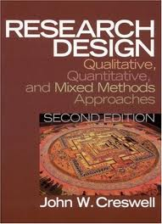
Teaching Experience
Research and Publications
Relevant experience in area of specialization
Publications, conference presentations
Grants, patents
Prepare a separate Statement of Research

Slide 28
Teaching Experience
Publications and Papers
BOOK REVIEW
Rocco, T. S. (2008). The aging workforce: realities, myths, and implications for organizations by Jerry W. Hedge, Walter C. Borman, & Steven E. Lammlein. Educational Gerontology, 34(2), 163-164.
PAPERS PUBLISHED IN PROCEEDINGS COMPETITIVE PEER REVIEWED (Local)
Landorf, H., Rocco, T., & Nevin, A. (2006).Creating Permeable Boundaries: Inclusive Educators in a Global Society. In M. Cleary, S. Nielsen, M. Plakhotnik (Eds.), Proceedings of the Fifth Annual College of Education Conference (pp. 58-63). Miami, FL: Florida International University.
INVITED PRESENTATIONS
Thijssen, Jo G.L. & Rocco, T. S. Career and Lifetime Development Revisited. Working at old age: Emerging theories and empirical perspectives on ageing and work. Cedefop, Thessaloniki, Greece 29-30 September 2008.

Slide 29
Teaching Experience
Service
May include
  Professional associations
  Volunteer work
  Committee membership
Such as
  Editorships
  Editorial Board Member
  Manuscript Reviewer
  University Service
  College Service
  Program and Department Service

Slide 30
References
Have a separate reference page
If asked to include in CV, add to the end
Include
  Name, phone, email, address (optional), context of relationship
  Inform references that they might be contacted
  Keep references updated; give them a copy of your CV
Carolyn Meeker
Assistant Director, Career Services Office
Florida International University
305-348-2423, cmeeker@fiu.edu
(Direct Supervisor for two years at UC Riverside)

Slide 31

Statement of Teaching Interests
Tell the reader what you feel competent to teach
If teaching biochemistry is a requirement,
  make it clear that you want to teach biochemistry

Slide 32
Writing a Statement of Teaching Philosophy
By Gabriela Montell
http://chronicle.com/article/How-to-Write-a-Statement-of/45133/
Break down the question
What do you believe about teaching? Why?
What do you believe about learning? Why?
How is that played out in your classroom?
How does student identity, background, and learning style make a difference in how you teach?
What do you still struggle with in terms of teaching and student learning?
Don’t include all of this, but think about it

Slide 33
Statement of Research and Scholarly Interests
2-4 page statement of past, current, and future research interests
Describe your past and present methodology, lab skills, and results
Tell what you hope to do for the next 3-5 years and how you can involve students
Refer to patents, publications, grants
Passion for Research “Somewhere, something incredible is waiting to be known."
Dr. Carl Sagan American astronomer, writer, and scientist 1934-1996

Slide 34
Writing a Statement of Research
Mention potential collaborators and sources of funding
http://chronicle.com/forums/index.php/topic,21211.0.html
People have different opinions about everything
1-2 pages properly cited should be enough to tell anyone your major research efforts. If it isn't, perhaps you are trying to accomplish too much.
…I've seen good statements that are 6-7 pages… What I would worry about is whether your proposal is relevant to the type of institution…

Slide 35
Dissertation Abstract
Clear, concise summary of work
  Placing it within scholarly context
  Noting contribution to the field
Comprehensible to people out of field, but scholarly enough to interest those within
Typically 1-2 pages appended at the end of CV

Slide 36
References
3-5 objective references; personal only if requested
“References available upon request” not required
Separate “References” page with your contact info
Name, title, work address, work phone, work email
Ask reference before and thank after!
Plan Now
Notes:
Make sure to tell the students to inform the references that they are being used as references. It is a good idea for students to send out their job descriptions to the references, therefore the references know what job the student is applying to.

Slide 37
Cover Letter
1 page; concise
  Why you’re applying to the program or position
  Relevant background
Inform reader of what you’re enclosing
  CV, statements, and teaching interests
  Don’t discuss these items in the cover letter
Perhaps use Department letterhead and professional address, if possible
Notes:
Make sure to tell the students to inform the references that they are being used as references. It is a good idea for students to send out their job descriptions to the references, therefore the references know what job the student is applying to.

Slide 38
Research the Employer
How do your experience, skills, abilities, and interests meet their needs?
Show why you are a good fit
Send to a specific person whenever possible
If you can’t find a specific name or title:
  “Dear Hiring Manager”
  “Dear Selection Committee”
Notes:
Make sure to tell the students to inform the references that they are being used as references. It is a good idea for students to send out their job descriptions to the references, therefore the references know what job the student is applying to.

Slide 39
Analyze Job Description and Your Background
Match responsibilities and qualifications
Draw from similar experiences, if nothing direct
Coursework and projects
Work experience and internships
Volunteer experience and community service
Student and professional associations
Extracurriculars
Travel
Notes:
Make sure to tell the students to inform the references that they are being used as references. It is a good idea for students to send out their job descriptions to the references, therefore the references know what job the student is applying to.

Slide 40
Paragraphs
Professional letter with address, date, etc.
1st paragraph
          What position you’re seeking
          How you learned of the opportunity
          If a specific person recommended that you apply
Last paragraph
          Thank reader for your time
          Invite reader to follow up with you
          Leave contact information
          Sign
Notes:
Make sure to tell the students to inform the references that they are being used as references. It is a good idea for students to send out their job descriptions to the references, therefore the references know what job the student is applying to.

Slide 41
Cover Letter Do’s
Make it original and targeted for the job
Mention position in first paragraph
Show how your career goals align with the position and organization
Succinct points supporting readiness to contribute
Proofread – no typos
Follow up if you don’t hear back after 2-3 weeks
  Chance to ask if more information is needed and reiterate interest
Invite employer to follow up with you
Notes:
Make sure to tell the students to inform the references that they are being used as references. It is a good idea for students to send out their job descriptions to the references, therefore the references know what job the student is applying to.

Slide 42
Cover Letter Don’ts
Generic
Typos
Long-winded introduction
Longer than one page
Ramble on about your experience without explaining the importance
Make the employer hunt for useful information
Explain what the employer can do for you
Notes:
Make sure to tell the students to inform the references that they are being used as references. It is a good idea for students to send out their job descriptions to the references, therefore the references know what job the student is applying to.

Slide 43
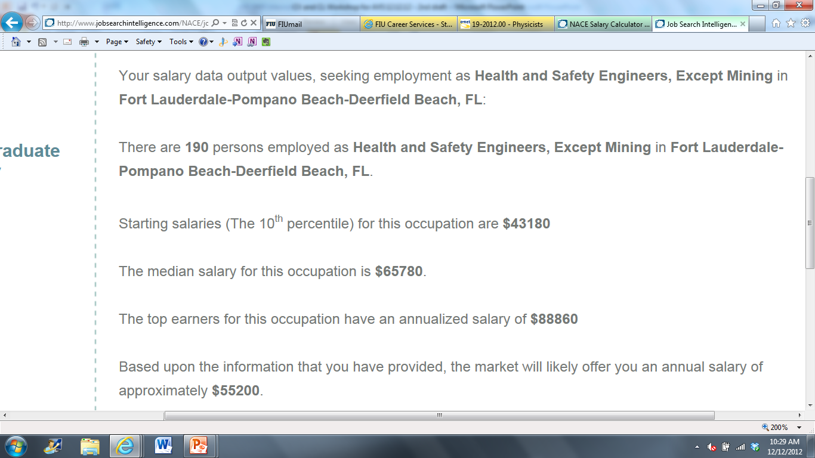
NACE Salary Calculator
Dg
Dfg

Slide 44
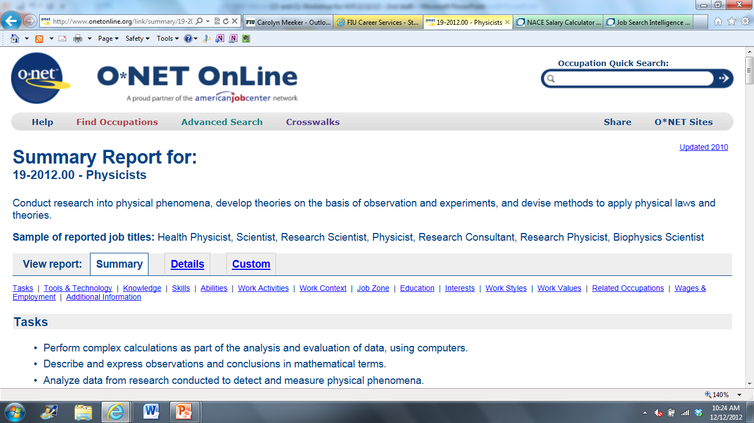
ONET Online
Dg
Dfg

Slide 45
Career Fairs & Conferences
Meet with employers at a convenient location
Network with a variety of companies
Make great 1st impressions
Might have on-site interviews

Slide 46
30 Second Elevator Speech
Objective:
  To provide basic information about you.
  To impress with your knowledge about the company.
  To state how your experience, education, and leadership skills can be used for the position.
Guidelines:
  Correctly structured (Perhaps follow resume).
  Always connect what you say with the company’s needs.
  Customize to the position applying for.
Name, Major, EGD
Objective
Interests/ Reasons for being here
Top Knowledge, skills and/or abilities (*If time permits*)

Slide 47



Attire and Presentation
Casual | T-shirt, polo, or casual blouse Jeans, pressed shorts, sun dress, or skirt Sandals or open-toe shoes
Business Casual | Interpretations vary & can be confusing No jeans (typically) or t-shirts No tennis shoes or flip-flops No club wear Collared shirt with a tie or a jacket is okay
Career Fair Business Professional | Suit or Jacket and Tie Neat hair and fingernails Minimal jewelry, cologne, or perfume (if any) 2-piece suit or skirt suit in black, gray, navy, etc. White or conservative-colored dress shirt Closed-toe shoes For men: Tie in a solid color or simple pattern For women: Nylons when wearing a skirt

Slide 48
FIU Disability Resource Center
http://drc.fiu.edu/
GC 190: 305-348-3532
WUC 131: 305-919-5345
Create diverse learning environments that are usable equitable, inclusive and sustainable.
Disability Specialist will determine appropriate academic services and accommodations, depending on limitations in academic setting.
Will train students on how to access eligible accommodations. Students will then be responsible for requesting most accommodations in a timely manner and for following DRC policies and procedures for accessing accommodations.

Slide 49

  Questions or Feedback?
http://career.fiu.edu
Modesto A. Maidique Campus Biscayne Bay Campus Engineering Center
GC 230 305.348.2423 WUC 255 305.919.5770 EC 2780 305.348.1281

