Slide 1
A Charged Fusion Product Diagnostic for a Spherical Tokamak
Proposal Defense
Ramona V Perez

Slide 2
Outline
Background
Experimental Design
Mechanical Design
Simulations
Electronic & Data Acquisition Design
Data Collection
Data Analysis
Timeline

Slide 3
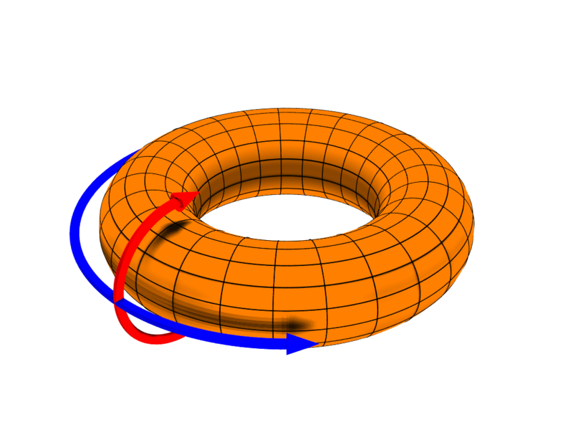
Confined Plasma
Poloidal & toroidal direction
Temperature 10^8 K
Magnetic field .5T
[Image 1]

Slide 4
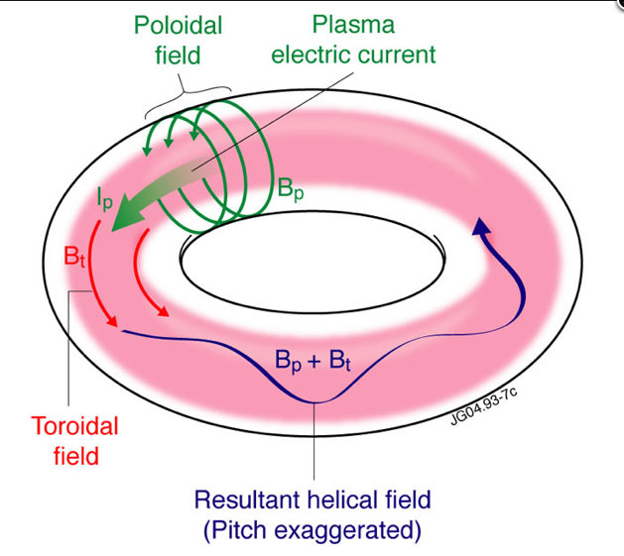
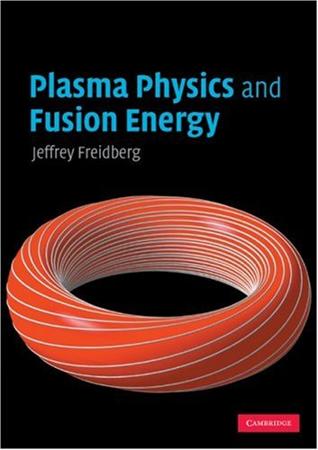
Confined Plasma
[Image 3]
[Image 2]

Slide 5
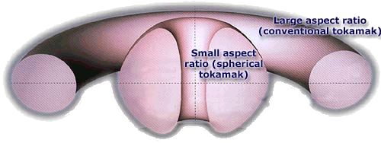
Spherical Tokamak
ac
Rc
Rs
as
Aspect Ratio: R/a
[Image 4]

Slide 6
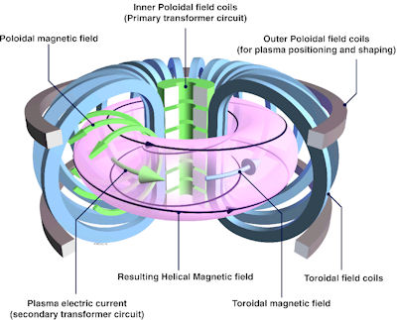
Tokamak Field Coils
[Image 7]

Slide 7
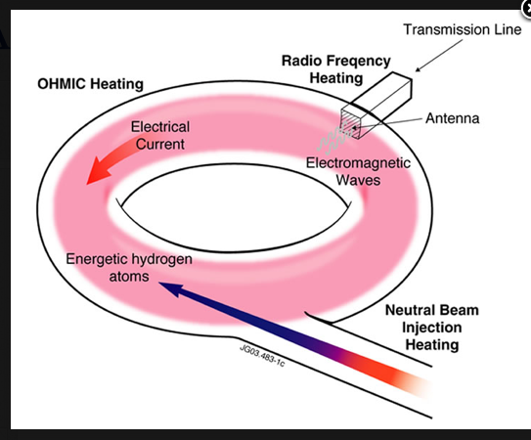
Heating Methods
Ohmic heating (induced current)
Neutral-Beam Injection (NBI)
And Radio Frequency (RF) (oscillating electromagnetic waves)
[Image 8]

Slide 8
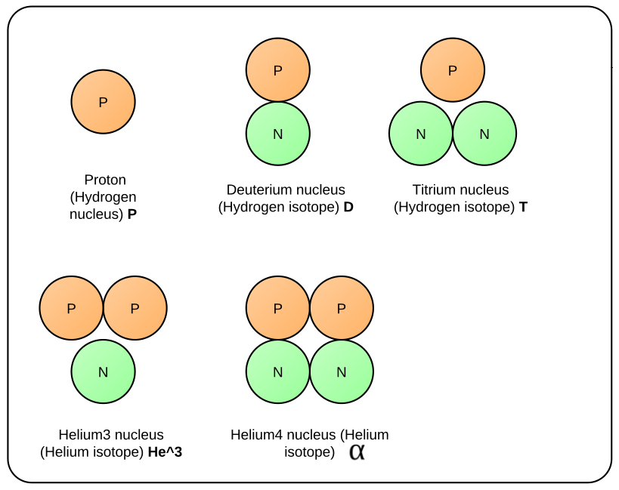
Products and Reactants

Slide 9
Fusion Reactions
Detect these
Primary reactions
D + D → P(3MeV) + T(1MeV)
D + D → He³(0.8MeV) + N(2.5MeV)
Secondary reactions
D + T → N(14.1MeV) + α(3.5MeV)
D+ He³ → α(4.6MeV) + P(13.7MeV)

Slide 10
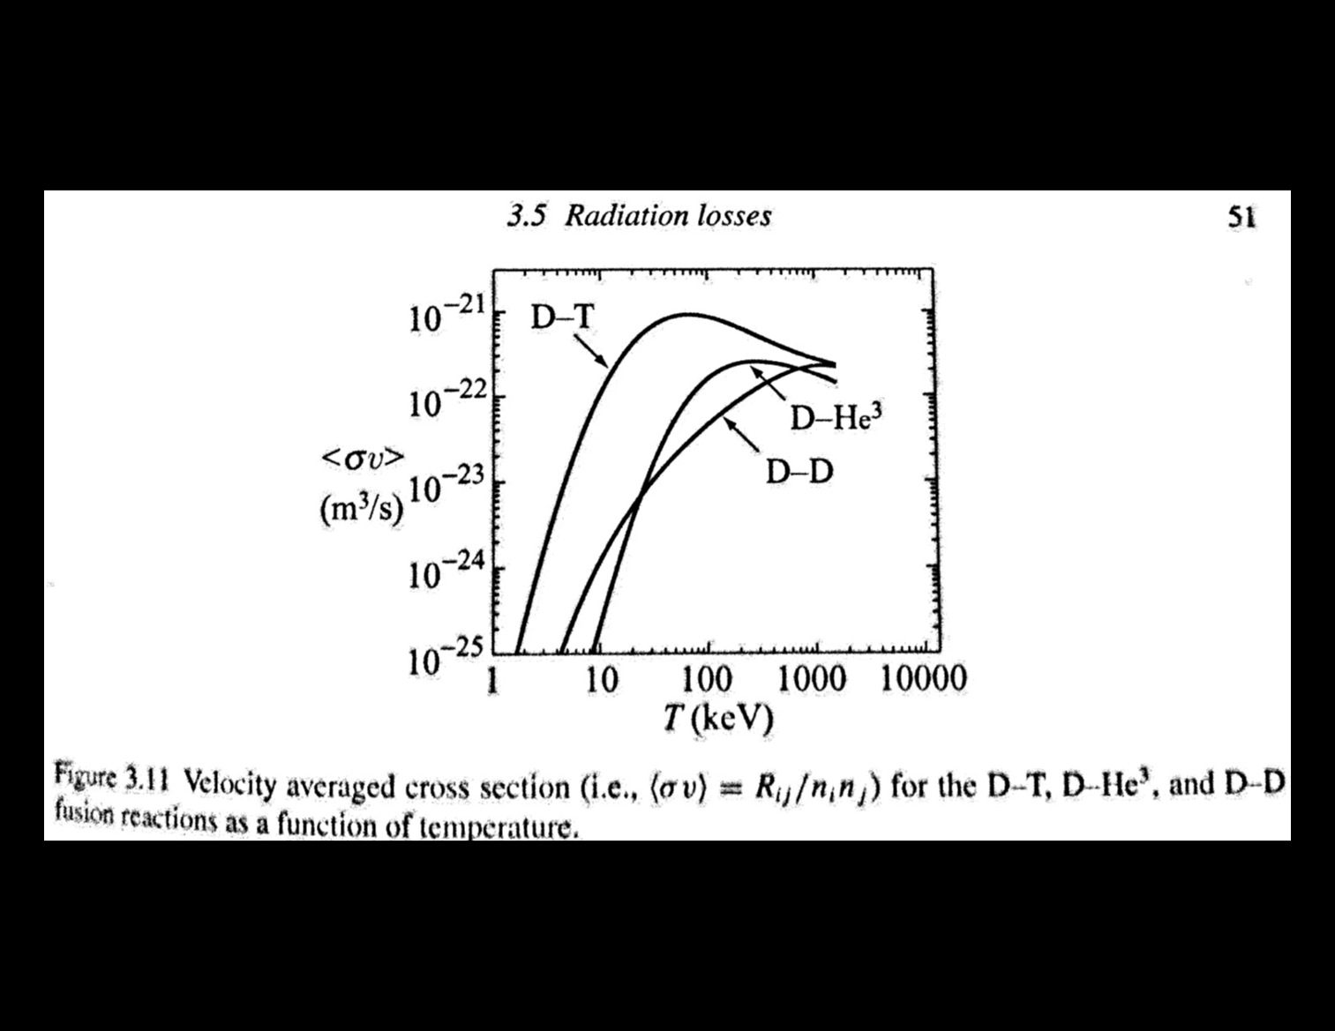
DD Reaction
Energy investment to facilitate nuclear reactions
[Image 10]

Slide 11
Research Objective
Determine emission profile
Where are the d(d,p)t reactions taking place in the plasma?
At what rate are these d(d,p)t reactions taking place in the plasma?
MHD instabilities
Provides foundation for future work with spherical tokamaks

Slide 12
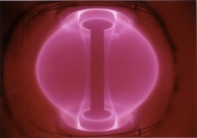
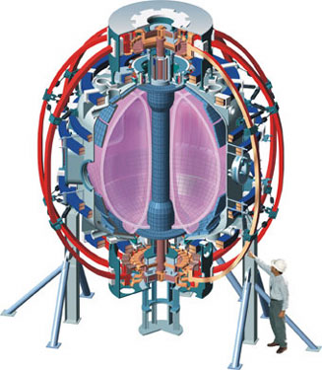
NSTX and MAST
[Image 6]
Tokamak
[Image 5]

Slide 13
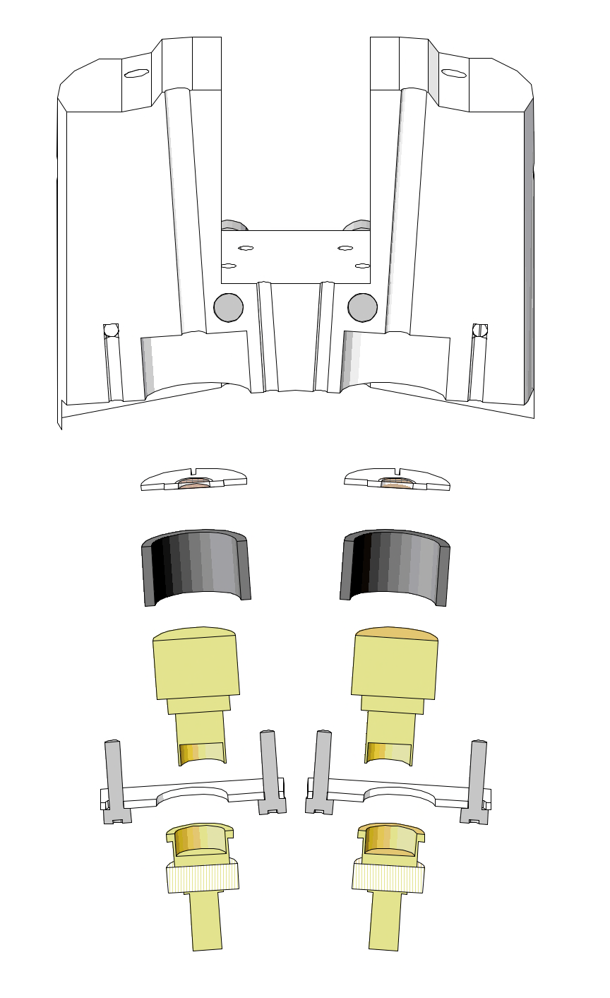
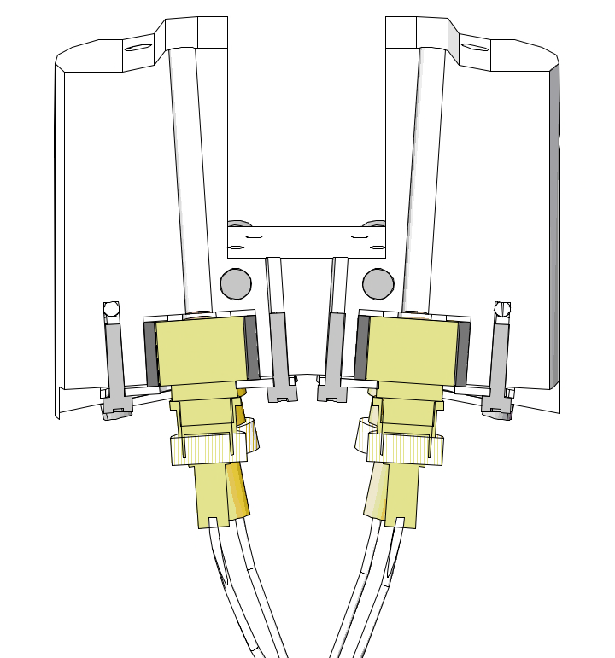
Module Cross Section
Foil
Insulator
Detector
Base
BNC connector

Slide 14
Total Exploded View
MAST RP
connector
Connector
Base X 4
Detector X 4
Insulator X 4
Foil X 4
Module
Shield

Slide 15
Total Assembled View
MAST
Reciprocating
Probe
Diagnostic
Shield
Diagnostic
Without Shield

Slide 16
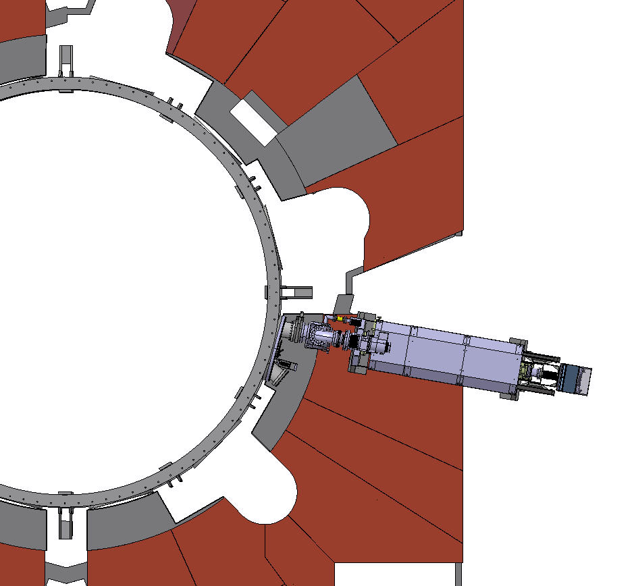
MAST mid-plane cross- sectional top view
Attach
diagnostic
Reciprocating probe
[Image 11]
15

Slide 17
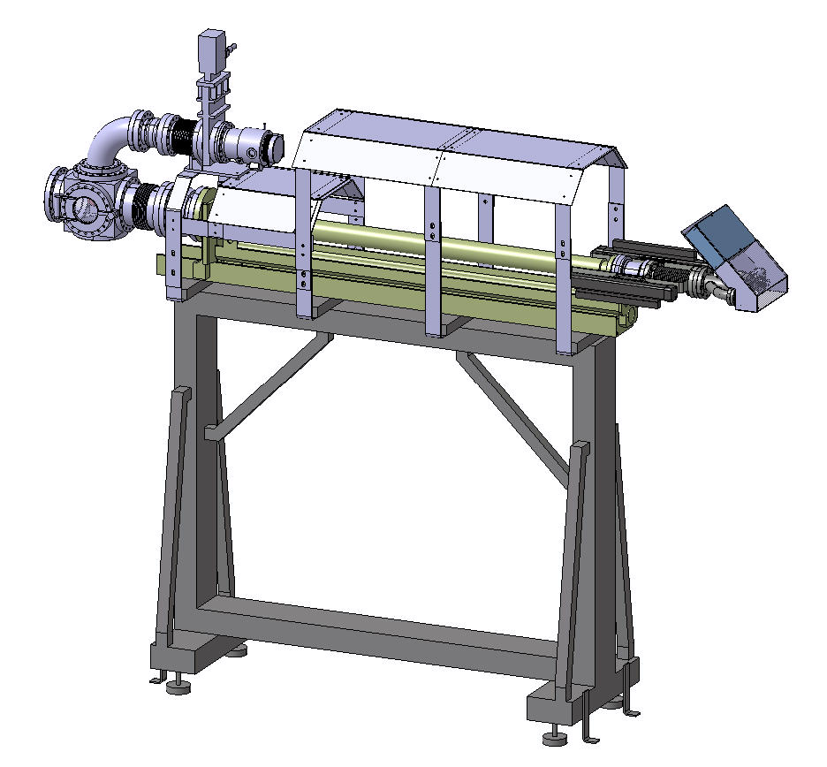
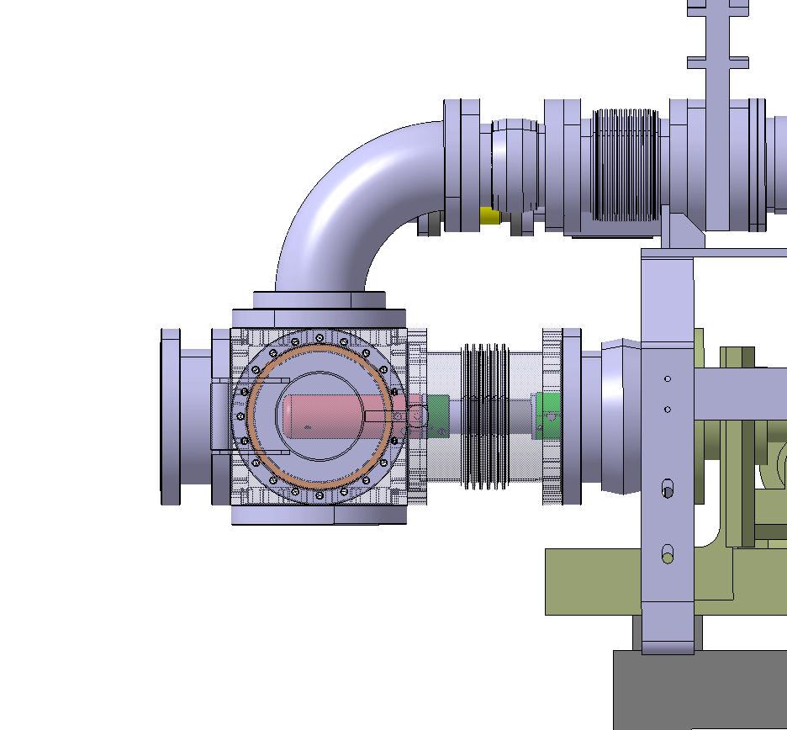
MAST RP Access Cube
[Image 14]
Clearance Diameter: 148mm
CFPD Diameter: 111mm
CFPD Length: 201.7mm = 185mm + 1.7cm
[Image 13]

Slide 18
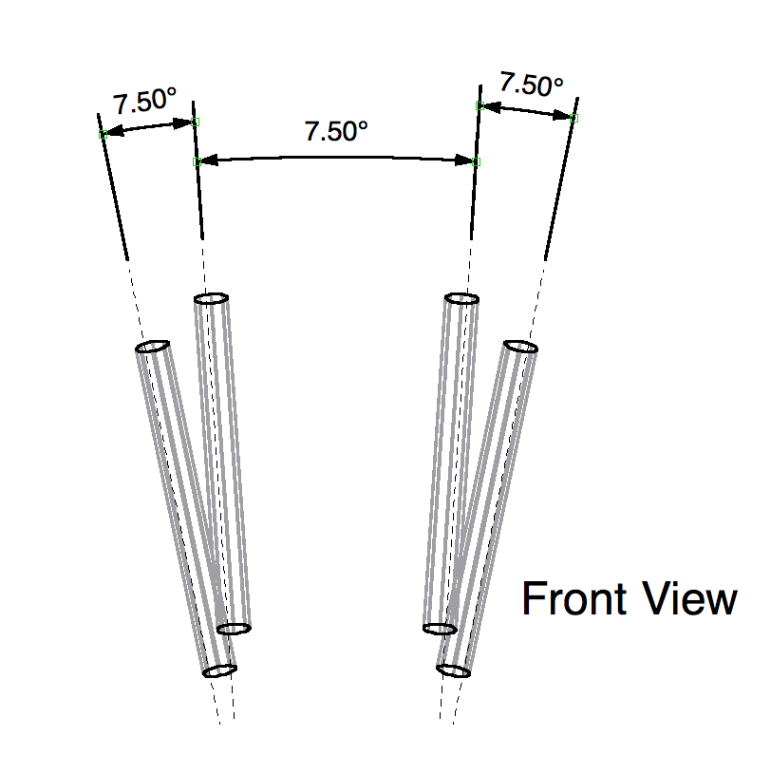
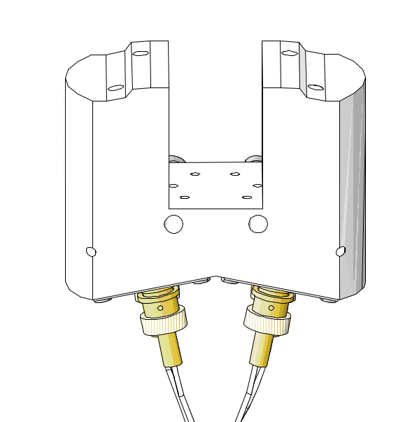
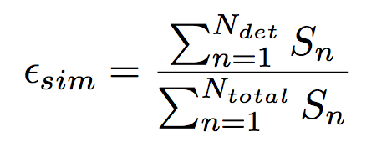
2.2 Simulations
Orbit Code
Recreate particle trajectory, or orbit, backwards in time

Slide 19
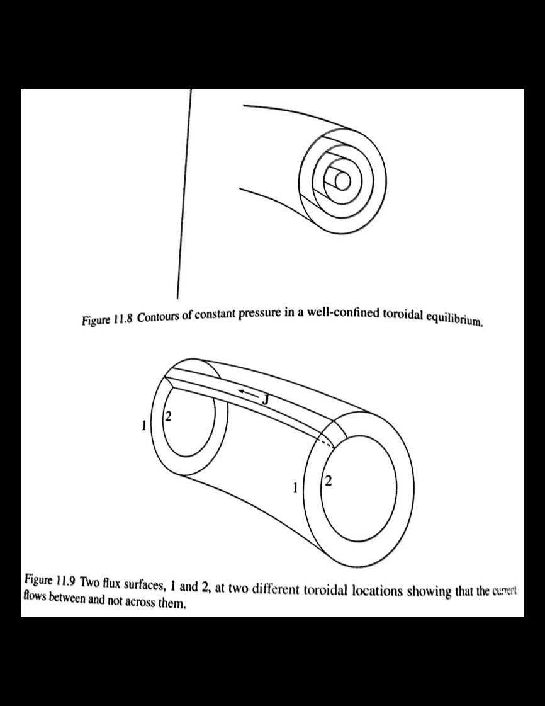
Flux Surfaces
Constant pressure
Constant temperature
[Image 15]

Slide 20
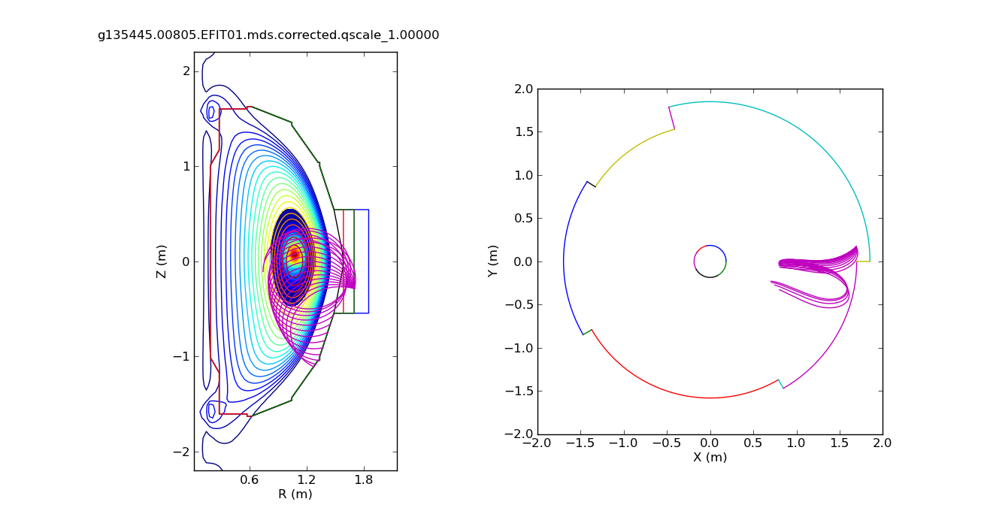
Particle Orbits
FLUX (CONTOUR
LINES)
EMISSIVITY (FILLED
CONTOURS)
CENTER OF TOKAMAK
TOKAMAK
WALL
DETECTORS
ORBITS
DETECTORS
ORBITS
TOKAMAK
WALL

Slide 21
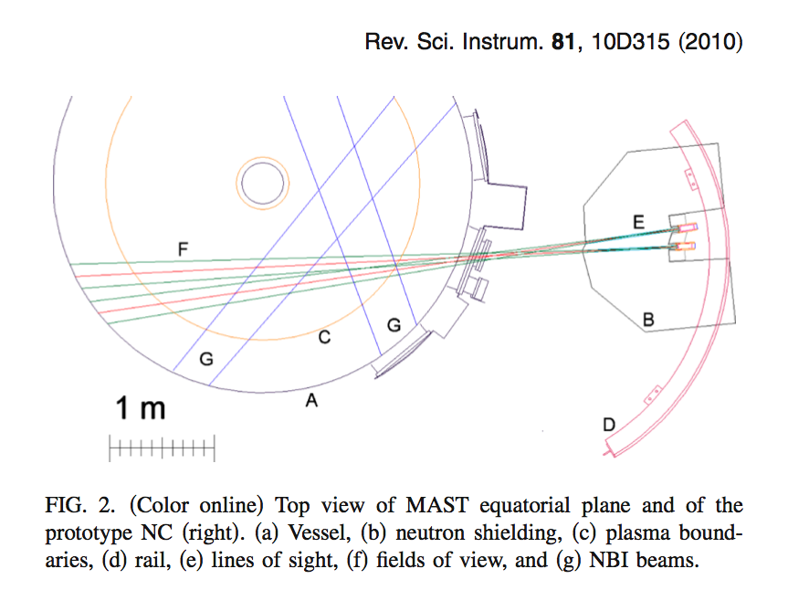
Other MAST Diagnostics
All diagnostics on the tokamak study the same plasma
[Image 16]

Slide 22
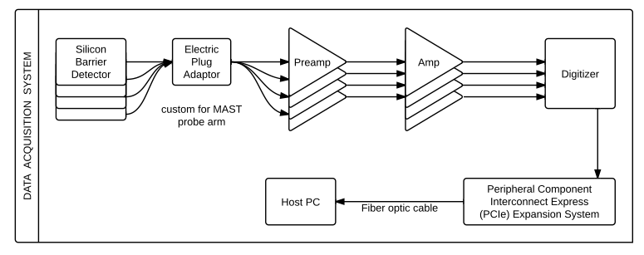
2.3 Electronics & DAQ Design

Slide 23
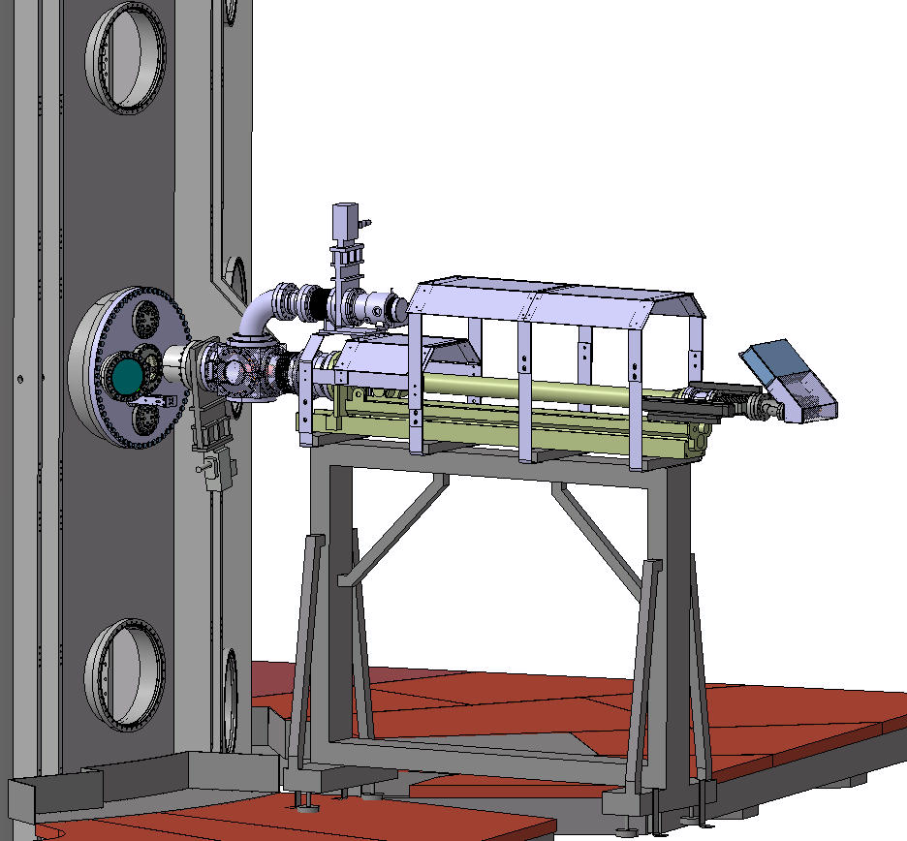
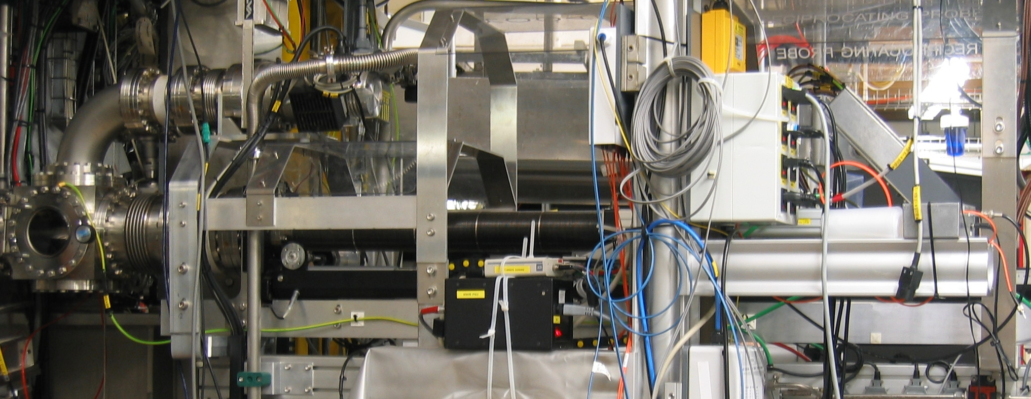
MAST RP side view
Access Cube/
Garage
[Image 17]
Linkbox

Slide 24
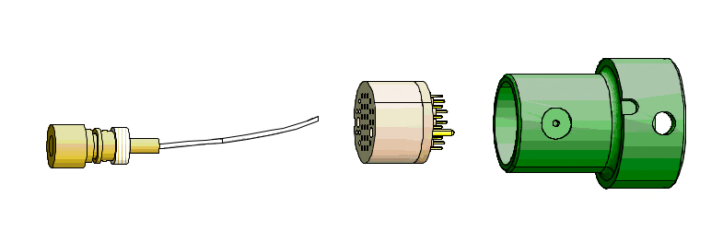
MAST RP Access Cube
MAST will connect non terminated cable ends from detectors to RP connector

Slide 25
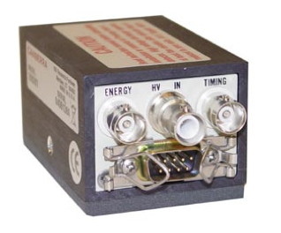
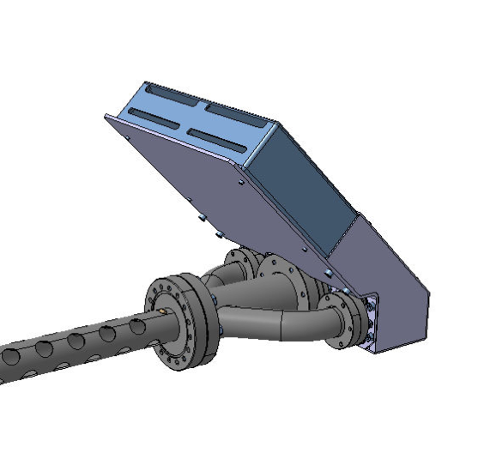
MAST RP Linkbox
4 preamplifiers stored inside linkbox
MAST will connect non terminated cable ends from preamplifiers to RP
Bias supply and power supply cables to preamp will run into linkbox
[Image 18]

Slide 26
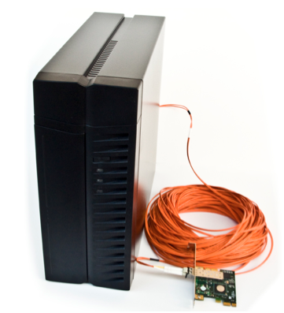
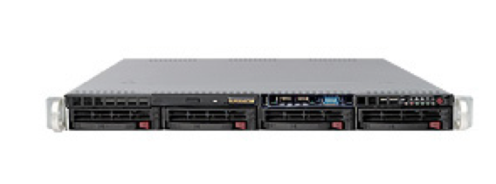
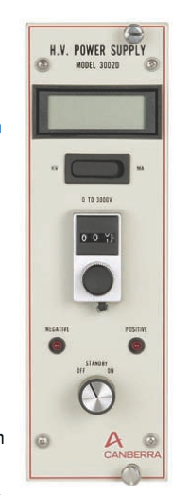
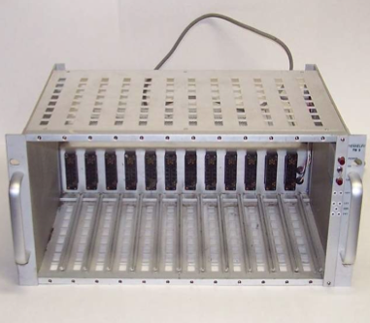
Hardware Storage
10m from MAST RP
4 amplifiers
1 NIM BIN
1 rack mount computer
1 PCI extension box
4 power supplies for detector bias Voltage
[Images 19-23]

Slide 27
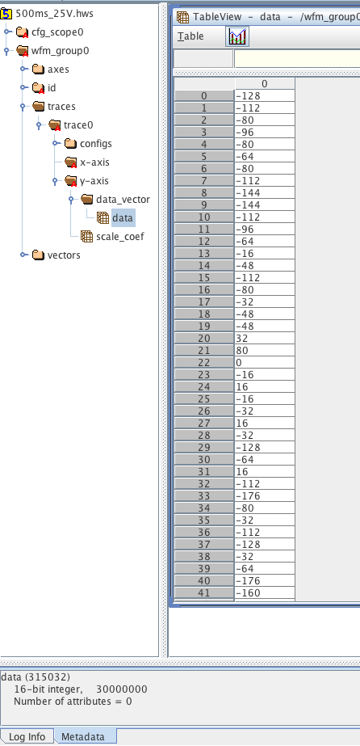
Data Files (HDF)
Data file sizes
23MB per channel per shot
92MB per shot for all channels
46GB for 10 days (2 weeks) data collection
92GB for 4 weeks data collection
Data Storage
150GB onsite rackmount computer
800GB FIU host computer

Slide 28
3. Data Collection: Round 2
Initial noise diagnostics and Electrical Design Review
January/March 2013
The Mega Amp Spherical Tokamak (MAST) at in the Culham Centre for Fusion Energy (CCFE) in the United Kingdom
Diagnostic installation and subsequent data collection
May/ June 2013
The Mega Amp Spherical Tokamak (MAST) at in the Culham Centre for Fusion Energy (CCFE) in the United Kingdom

Slide 29
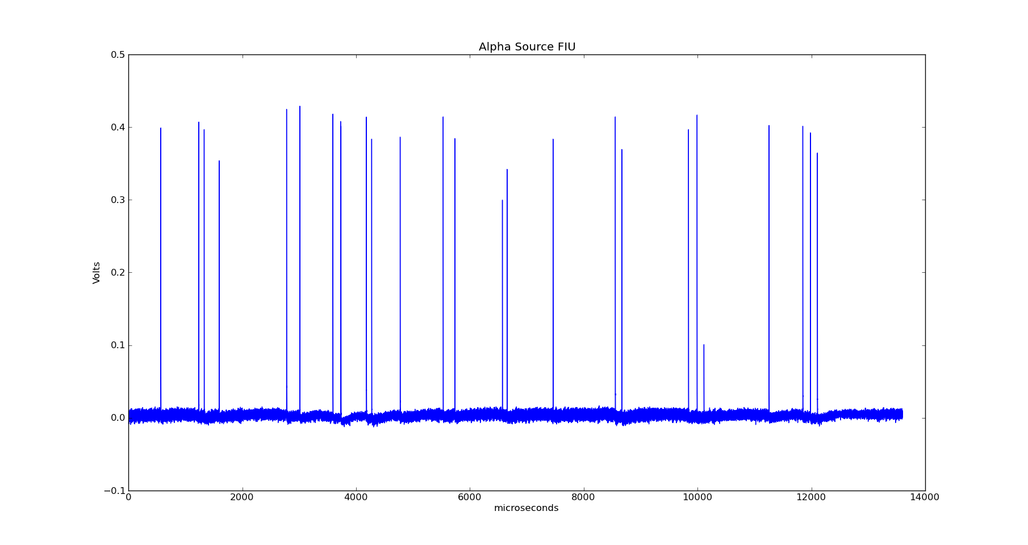
4. Data Analysis
Example of pulse signals, 5.5 MeV alpha particles

Slide 30
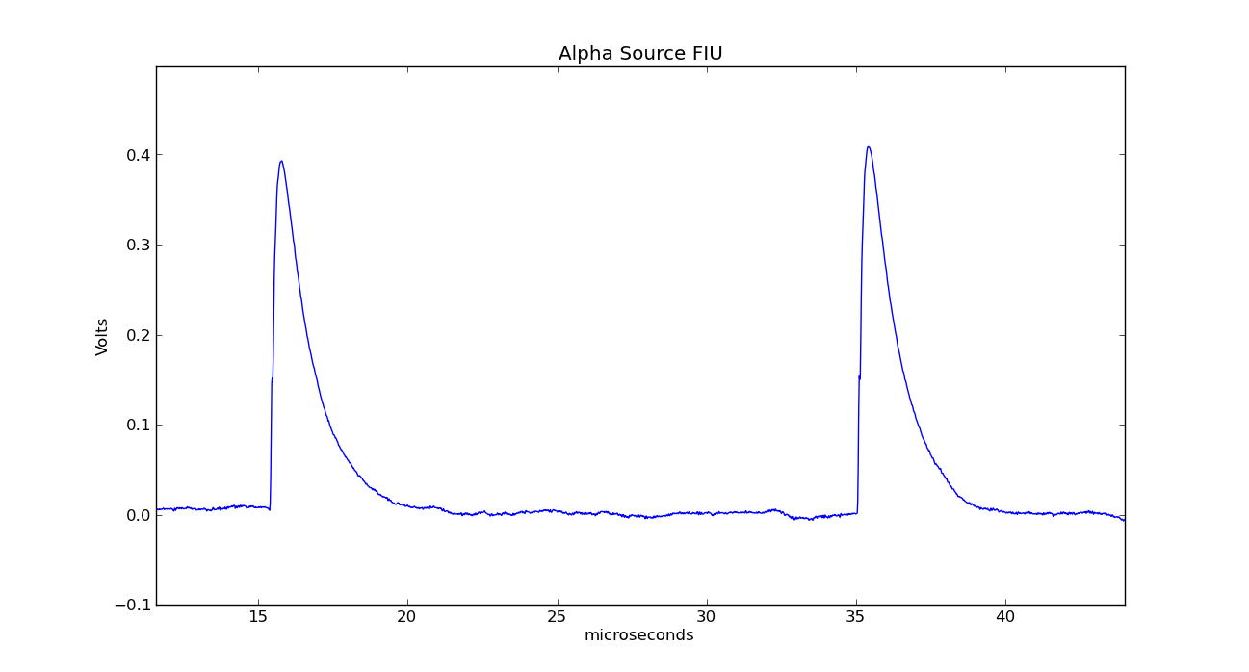
Find Peaks for Protons

Slide 31
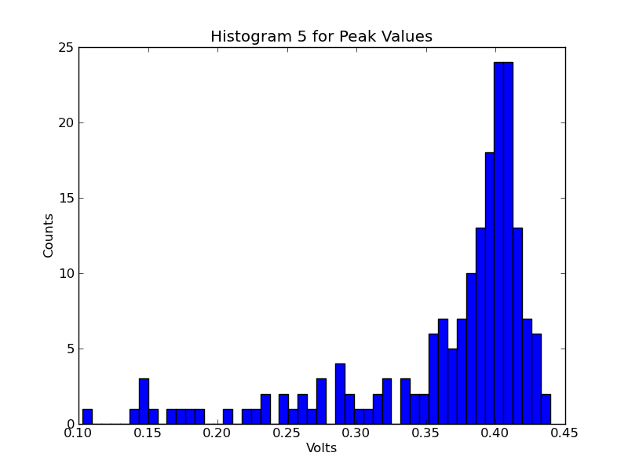
Bin Peaks

Slide 32
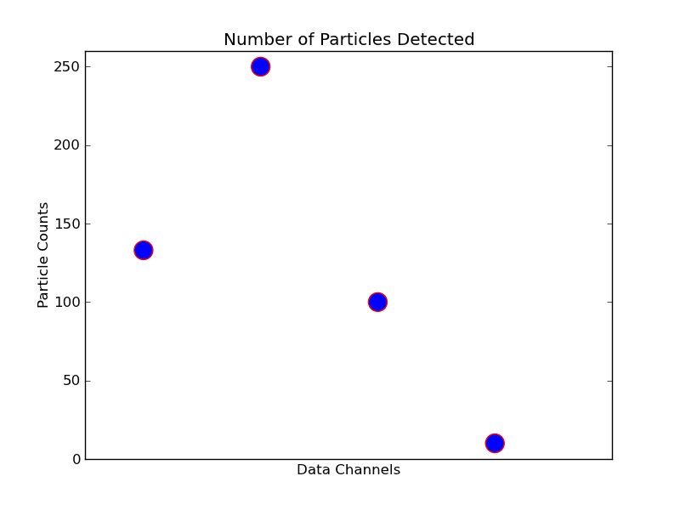
Count Particles Detected

Slide 33
Emissivity
Ratio of particles detected (counted) and MAST global yield rate proportional to below expression
Simple models of emissivity will be fitted to data

Slide 34
5. Tentative Timeline
TERM | GOALS
SUMMER 2012 | Diagnostic design/ assembly/ testing
FALL 2012 | Continue summer goal, apply for 2014 fellowship
SPRING 2013 | Initial testing & Electrical Design Review at MAST
SUMMER 2013 | Diagnostic installation and data collection
FALL 2013 | Data analysis, dissertation, apply for 2015 fellowship
SPRING 2014 | Data analysis, dissertation
SUMMER 2014 | Write paper for publication, dissertation
FALL 2014 | Dissertation defense, submit paper for publication

Slide 35
References- Images
Unreferenced images are created by author
An image depicting the poloidal (red, called theta) direction and the toroidal (blue, called phi) directions. 13 September 2006. Made in POV-Ray by Dave Burke. PNG File.
European Fusion Development Agreement (EFDA). Magnetic fields in a tokamak. 2012. Garching, Germany. EFDA: Fusion. 08/01/2012. <http://www.efda.org/fusion/focus-on/plasma-heating-current-drive/ohmic-heating/>
Jeffrey Freidberg. Cover. Plasma Physics and Fusion Energy. Cambridge University Press, 2008.
Spherical Tokamaks Image. 2009. Abingdon, Oxfordshire, UK. Culhman Centre for Fusion Energy: Research. 08/01/2012. <http://www.ccfe.ac.uk/st.aspx>
Princeton Plasma Physics Laboratory. National Spherical Torus Experiment. Princeton, New Jersey. Alternative Energy Action Now. 09/01/2012. <http://www.alternative-energy-action-now.com/spherical-tokamak.html>
Spherical Tokamaks Image. 2009. Abingdon, Oxfordshire, UK. Culhman Centre for Fusion Energy: Research. 08/01/2012. <http://www.ccfe.ac.uk/st.aspx>
Tokamak Fields. Encyclopedia of Earth. 09/01/2012. imagehttp://www.eoearth.org/article/Nuclear_fusion_power.
European Fusion Development Agreement (EFDA). Heating of JET Plasmas. 2012. Garching, Germany. EFDA: Fusion. 08/01/2012. http://www.efda.org/fusion/focus-on/plasma-heating-current-drive/ohmic-heating/
Fig. 1. Fundamental quantum mechanical phenomena. 2012. Victoria Stafforda Psychic Investigation. 09/20/2012. <http://victoriastaffordapsychicinvestigation.wordpress.com/2012/07/01/line-19-a2a-semiconductor-heterostructures-schrodinger-quantum-confinement-5g-wow-seti/fig-1-fundamental-quantum-mechanical-phenomena-a-electron-reflection-and-interference-b-tunneling-effect-c-e-quantum-confinement/>

Slide 36
References- Images
Figure 3.11. Page 51, 2007. Plasma Physics and Fusion Energy. Jeffrey Freidberg. Cambridge University Press, 2007.
Side View of Assembled MAST Reciprocating Probe. CAD image created by the Culham Centre for Fusion Energy’s MAST Drawing Office. 2012. PDF File.
MAST Reciprocating Probe Access Cube. CAD image created by the Culham Centre for Fusion Energy’s MAST Drawing Office. 2012. PDF File.
Side View of MAST Reciprocating Probe. CAD image created by the Culham Centre for Fusion Energy’s MAST Drawing Office. 2012. PDF File.
Figure 11.8 and Figure 11.9. Page 262, 2007. Plasma Physics and Fusion Energy. Jeffrey Freidberg. Cambridge University Press, 2007.
Cecconello et al. FIG 2. MAST Neutron camera schematic. Rev Sci Instrum. 81, 10D315 (2010).
Scott Y. Allan. MAST Reciprocating Probe. Culham Centre for Fusion Energy. 2012. JPG File.
Linkbox MAST Reciprocating Probe. CAD image created by the Culham Centre for Fusion Energy’s MAST Drawing Office. 2012. PDF File.
Please ask for user manual, CANBERRA 2111 Timing Filter Amplifier.
Please ask for user manual, ADNACO S2 Fiber Optic PCI Bus Extender.
Please ask for user manual, SuperMicro 50161 MTF 1U Rackmount Server.
Please ask for user manual, CANBERRA 3002D 0-3 kV H.V. Power Supply.
Please ask for user manual, Tennelec TB-3 NIM BIN with TC-911 Power Supply System.

Slide 37
References
J. A. Bittencourt, FUNDAMENTALS OF PLASMA PHYSICS. Springer Science + Business Media, LLC, 3rd Edition, 2004.
W. U. Boeglin, R. Valenzuela Perez, D. S. Darrow, Rev. Sci. Instrum. 81 (2010) 10D301
Hans-Stephan Bosch, Rev. Sci. Instrum. 61, 1699 (1990)
L. F. Delgado-Aparicio, et. al., J. of Appl. Phys. 102 (2007) 073304
Jeffrey Freidberg, Plasma Physics and Fusion Energy. Cambridge University Press,2007.
Daniel H. Lo, Réjean L. Boivin, and Richard D. Petrasso Rev. Sci. Instrum. 66, 345 (1995)
J. D. Strachan, Rev. Sci. Instrum.57, 1771 (1986)
S. J. Zweben, Rev. Sci. Instrum.57, 1774 (1996)
S. J., Zweben, et al., Nucl. Fusion 35, 893 (1995)

Slide 38
Thank you for your time!
Questions

Slide 40
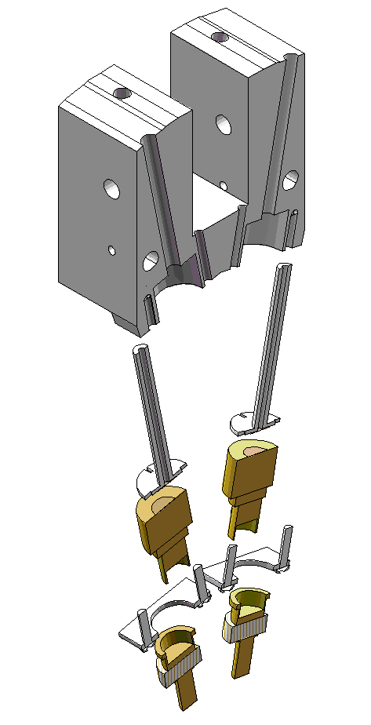
Alternate Washer to Change Collimator Size
New collimator size

Slide 41
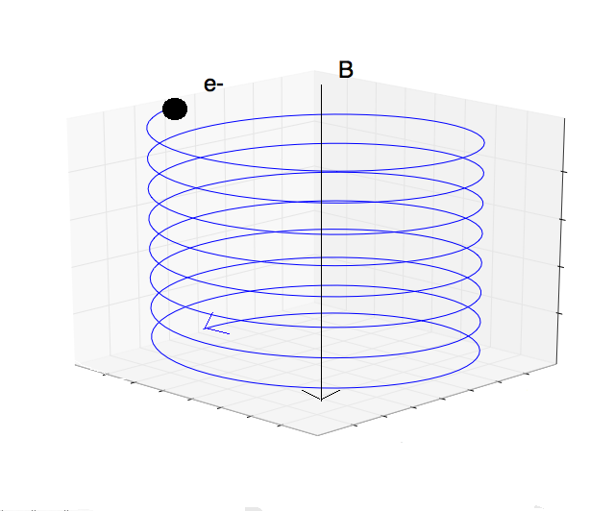
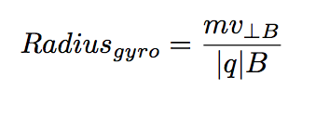
Particle Motion
How do particles move in these magnetic fields?

Slide 42
MAST RP side view
Access Cube/
Garage
MAST RP side view
Port
Vessel
Wall
Reciprocating
probe
[Image 12]

Slide 43
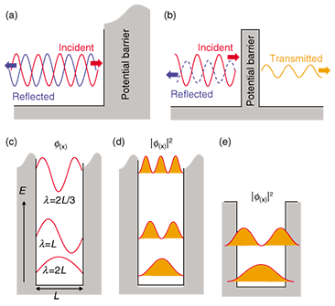
Tokamak
Facilitate nuclear reactions
[Image 9]

Slide 44
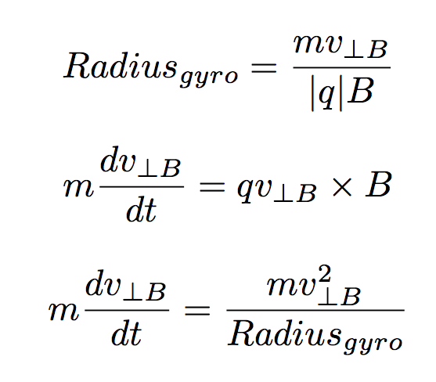
Gyro radius

Slide 45
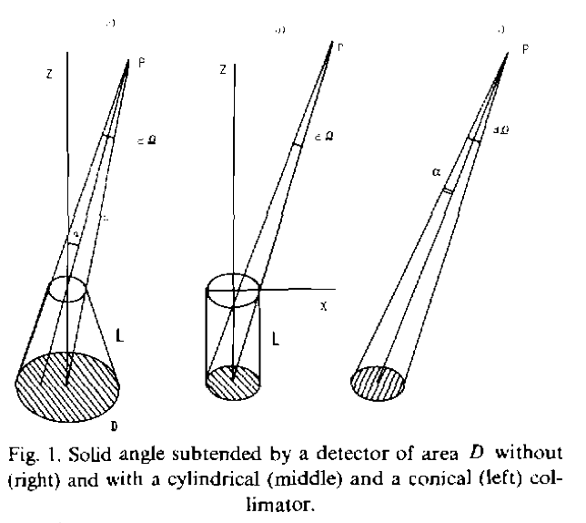
Collimator
[Image #]

Slide 46
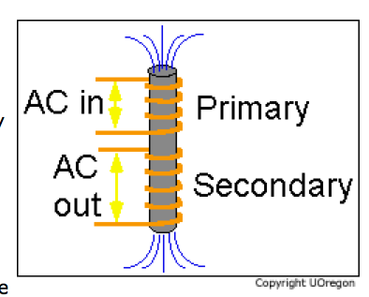
Transformer
[Image #]

Slide 47
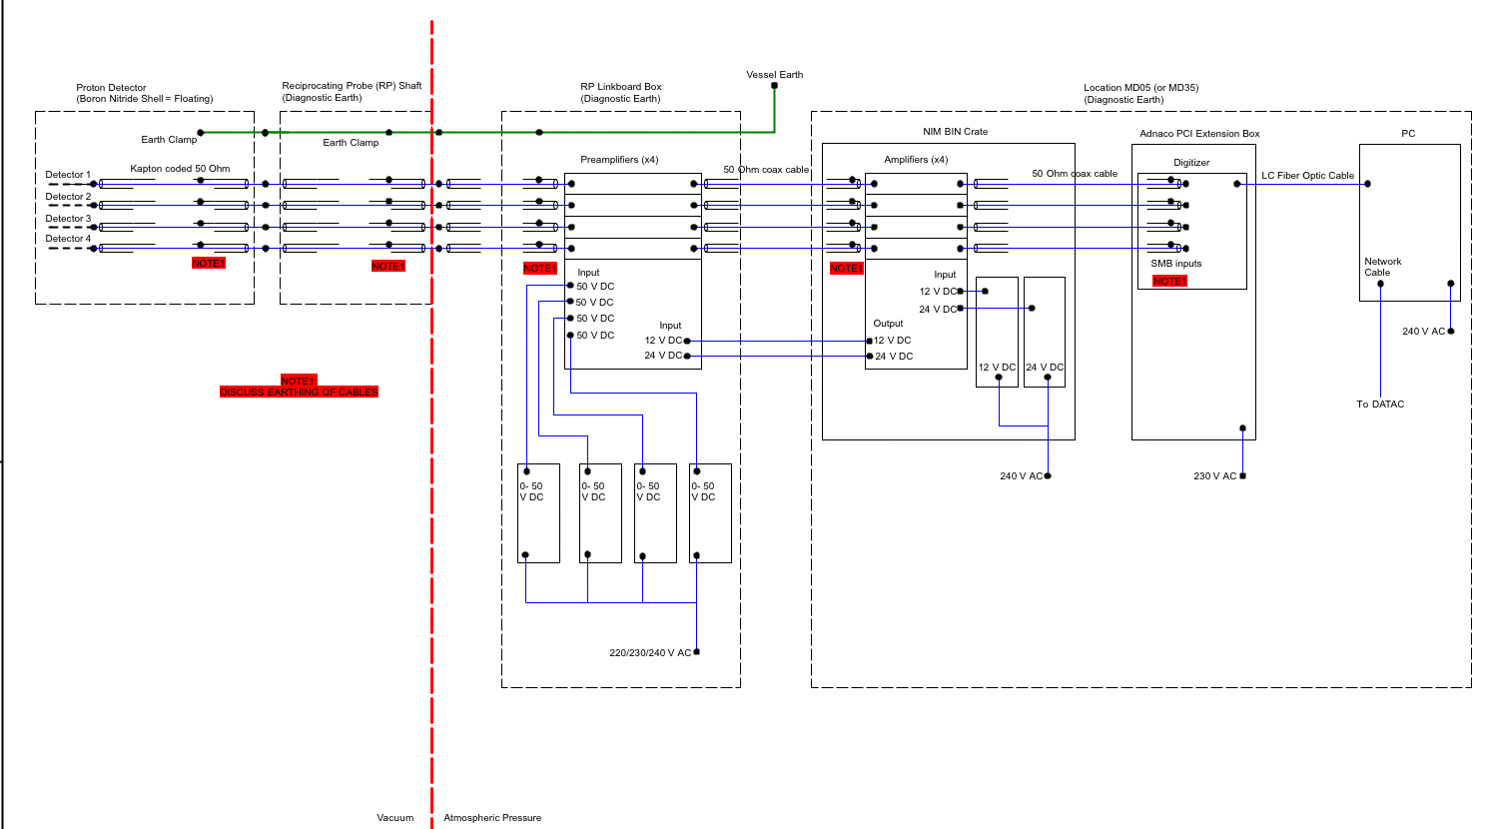
Electronics Schema

Slide 48
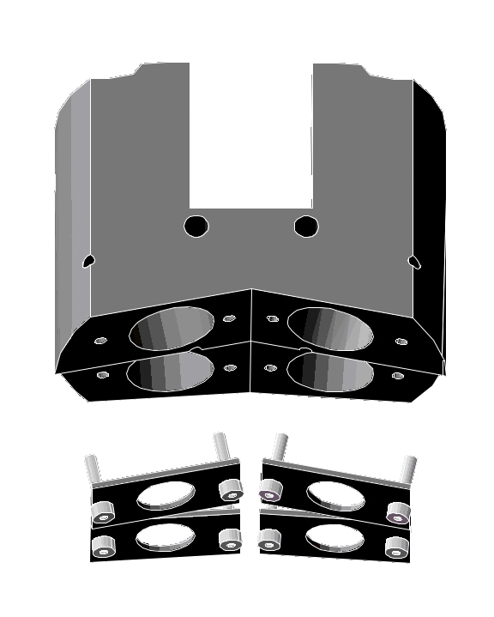
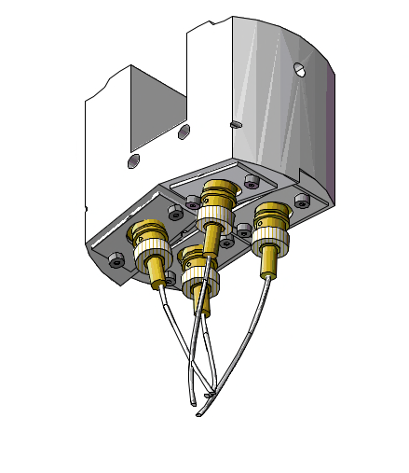
Module Exploded View with Bases

